Slide 1
EXECUTIVE SUMMARY
Multimodal Radiology
Diagnostics Pipeline
Automated chest X-ray analysis with Grad-CAM interpretability
for human-in-the-loop clinical validation
Presented by Ethan Saline

Slide 2
Background
Project Purpose
Data Source
A proof of concept for integrating machine learning into hospital medical systems. The pipeline ingests an X-ray image and
• Generates a radiology report
• Diagnoses the illness using probabilities
• Visualizes where the model focuses via Grad-CAM heatmaps
A human-in-the-loop review step validates all outputs before clinical decisions are made.
MIMIC-CXR — ~377,000 images & radiology reports
Currently: 1,200 reports active | Target: 5,000+
200 new X-rays + reports ingested weekly
Training Schedule & Deployment
Partial retraining every Sunday at midnight simulating real hospital patient influx.
Designed for direct integration into the most common U.S. hospital EHR system.

Slide 3
Methodology: Five-Step Pipeline
1
2
3
4
5
ENCODE
RETRIEVE
REPORT
DIAGNOSE
VALIDATE
BioViL encodes each DICOM into a
128-dim image embedding
FAISS retrieves 5 most similar
historical studies
(Recall@5: 89.7% @ 1,200 studies)
BioViL-T generates findings &
impression text from embedding
+ retrieved cases
CNN classifier receives 256-dim
image + report embedding and
outputs per-pathology probabilities
Grad-CAM heatmaps generated
for interpretability; outputs
persisted to PostgreSQL

Slide 4
Methodology — Storage & Label Strategy
Storage Architecture
Uncertainty Label Strategy
FAISS
Condition | Strategy | Reason
All conditions (default) | U-Ones → 1 | Clinically safer — false negatives are more harmful than false positives
Cardiomegaly & Atelectasis | U-Zeroes → 0 | Uncertain cases trend negative historically in CheXpert
Image embeddings vector store
PostgreSQL
Source of truth — all outputs & labels
Redis
Hot cache with 7-day TTL for fast retrieval

Slide 5
Architecture: Pipeline Scripts
Step | Script | Input | Output
1 | get_data.py | MIMIC-CXR PhysioNet | DICOMs in data/raw
2 | label_data.py | data/raw DICOMs | manifest.csv appended
3 | ingest.py | manifest.csv | Studies + labels in PostgreSQL
4 | encode.py | data/raw DICOMs | Embeddings in FAISS; DICOMs deleted
5 | retrieve.py | Image embedding | Top-5 similar cases with reports
6 | report.py | Embedding + retrieved cases | Findings + impression + report embedding
7 | diagnose.py | Image emb. (128) + report emb. (128) | Per-pathology probabilities
8 | train_classifier.py | All embeddings + labels | Updated CNN weights saved
9 | validate.py | All outputs | Heatmaps + final JSON to PostgreSQL

Slide 6
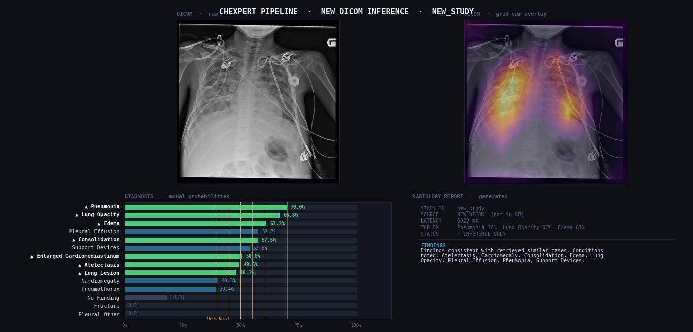
Results
0.72–0.82
89.7%
< 2 sec
AUROC
Pneumonia · Edema · Consolidation
Retrieval
Recall@5
Inference
latency per study
Example JSON Output
{ "findings": "Mild atelectasis at the left base...",
"impression": "No acute cardiopulmonary process.",
"diagnoses": { "pneumonia": 0.83, "effusion": 0.11 },
"confidence": 0.91 }
✓ Pipeline retrains automatically each week as new data accumulates
Grad-CAM heatmap — Kaggle X-ray correctly diagnosed
with pneumonia by both model and physician

Slide 7


Slide 8
Future Development
01
Build Heatmap per Condition
At the moment the heatmap generated is an “overall” but does not show where the model is looking to claim each diagnosis specifically.
02
U-Train Uncertainty Label Strategy
Replace the current U-Ones / U-Zeroes strategies with a self-trained uncertainty handling approach for improved label quality and more nuanced probabilistic outputs.
03
Epic / FHIR Integration
Connect the pipeline directly to the EHR so reports and diagnoses surface within the clinical workflow without manual export — enabling seamless human-in-the-loop review at scale.

Slide 9
Toward Hospital Ready
Radiology ML
A scalable, interpretable, and clinically safe pipeline
for augmenting radiologist workflows with machine learning
Presented by Ethan Saline

